Slide 1
Best Practices with Views in Couchbase Server
David Maier
Principal Solutions Engineer

Slide 2
Agenda
Introduction
Ways to Query
Database Design Considerations for Views
Configuration Settings and their Effects
Resource Requirements

Slide 3
Introduction

Slide 4
Introduction
Focus
on Indexing via Views
Not covering
the new Global Secondary Indexes in 4.0
3.x

Slide 5
Introduction
Views are a powerful feature for real time applications
Indexing can be a pretty heavy weighted operation
Indeed use case dependent!
10%
90%
Patch
Management
Many others..
Views/Queries
Key Access

Slide 6
Ways to Query
with Couchbase Server

Slide 7
Key Patterns
Retrieval via key patterns
e.g. person::$firstname_$lastname
With a lookup document
e.g. just 2 steps to retrieve a user by his email address
Efficiency
B-Tree traversal vs. direct access

Slide 8
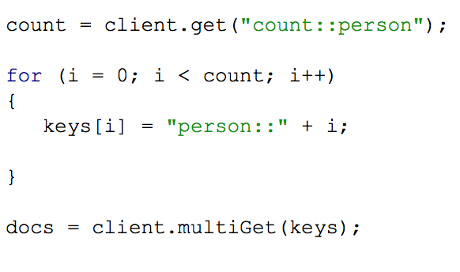
Key Patterns
Multi-get by using a counter value

Slide 9
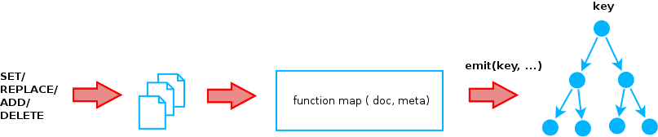
Indexing and Querying via Views
Organized in Design Documents
Incremental Map-Reduce
Spread load across nodes
Each node indexes it’s data
Map | Reduce
Process, filter, map and emit a row | Aggregate mapped data Built in: _count, _sum, _stats

Slide 10
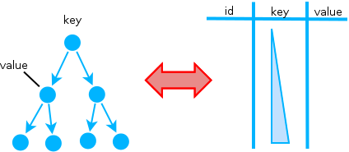
Indexing and Querying via Views
Multiple roles
Primary Index: All document id-s
Secondary Index: Alternative access path regarding (compound) key attribute
View: Alternative view on data

Slide 11
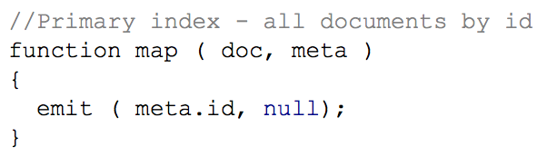
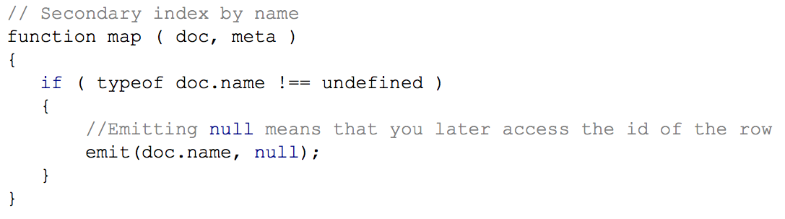
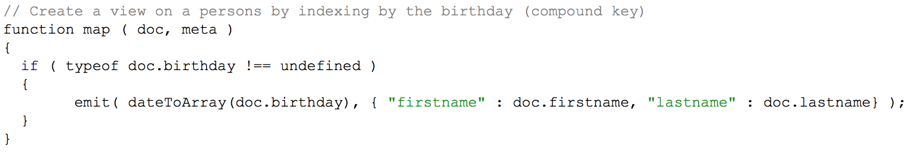
Indexing and Querying via Views

Slide 12
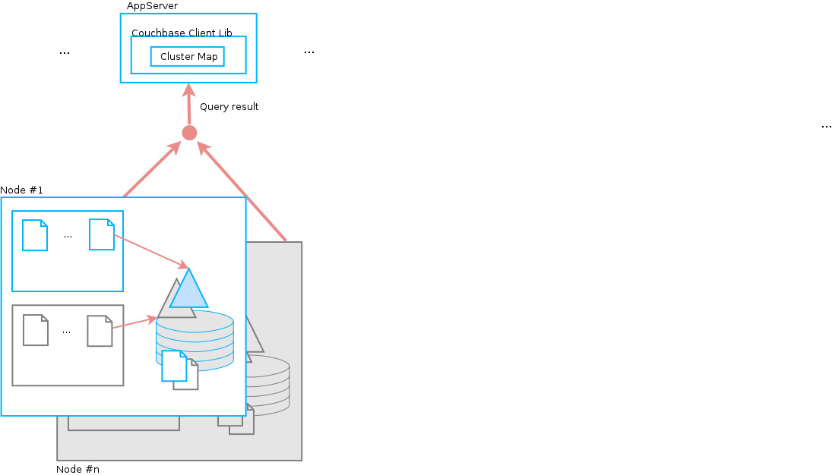
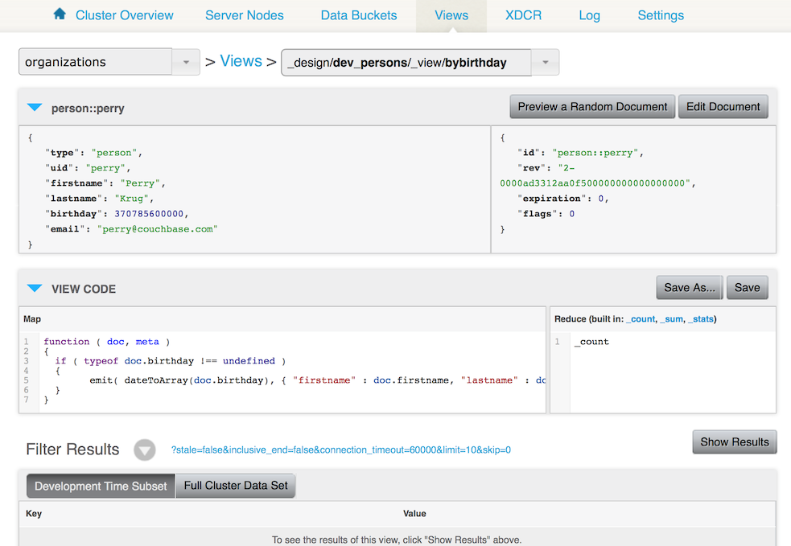
Indexing and Querying via Views

Slide 13
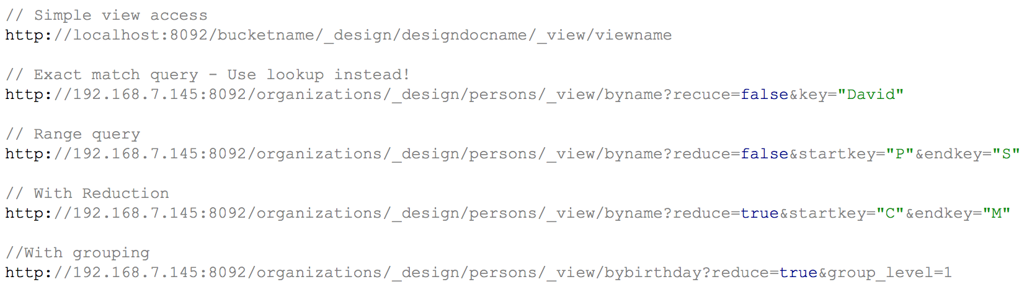
Indexing and Querying via Views
Simple View access
Exact match query
Range query
With reduction
With grouping

Slide 14
Best Practices - Selection, Projection, Aggregation
Try avoid computing too many things in a View
Check for attribute existence
Pre-Filter data to avoid unnecessary entries in the View
Use document types to make Views more selective
Project (map) only necessary data by emitting it as part of the value
Do not emit the full document
Back-reference via the original document id
Use the built-in reduce functions if possible

Slide 15
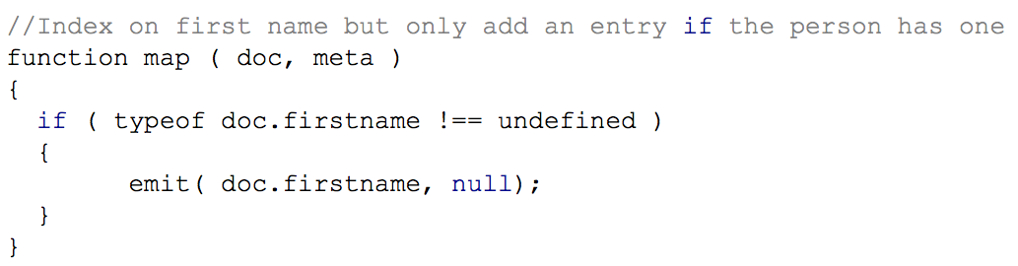
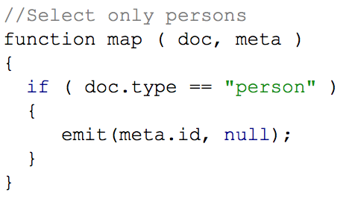
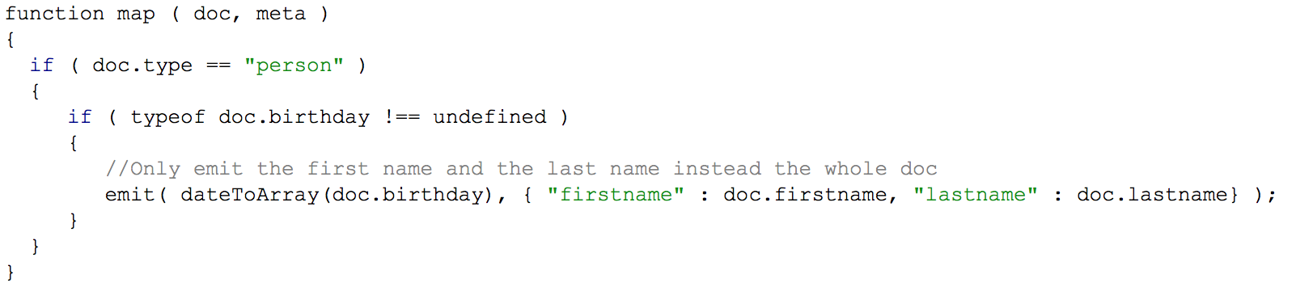
Best Practices - Selection, Projection, Aggregation

Slide 16
N1QL – Developer Preview
SQL like query language
Extended syntax
Can use several index implementations
ForestDB - Global Secondary Indexes
Couchstore Views - Only those were created via N1QL
CREATE PRIMARY INDEX ON `beer-sample`;
CREATE INDEX `beer-sample-type-index` ON `beer-sample`(type);
SELECT brewery_id FROM `beer-sample` WHERE name = 'Doppelbock';

Slide 17
How Indexing works
in Couchbase 2.x compared to 3.x

Slide 18
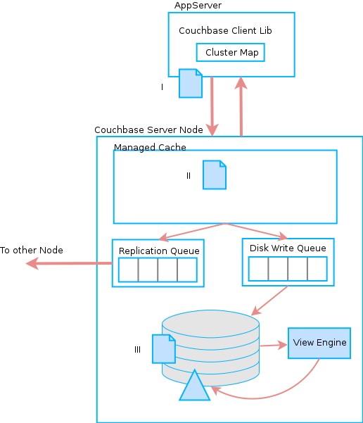
2.x Architecture

Slide 19
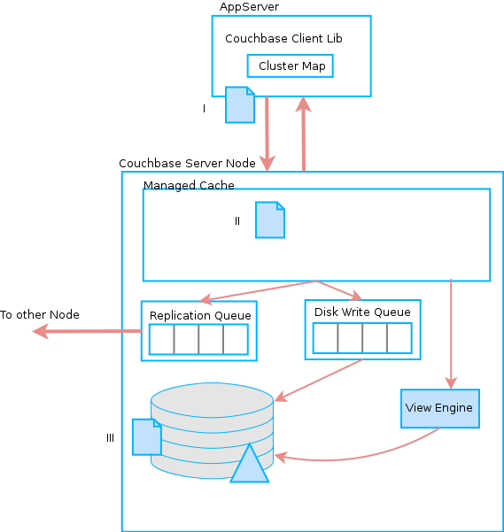
3.x Architecture

Slide 20
The Semantic of ‘stale = false’
Stale = false
Default is ‘update after’
Used to enforce index update at query time
2.x
Eventual indexed
Eventual consistent
Hit disk before indexed
3.x
Indexed from memory so semantically correct

Slide 21
Database Design Considerations
for Views

Slide 22
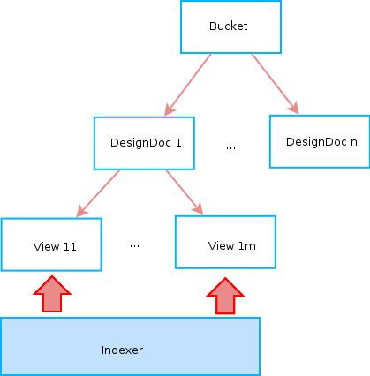
Number of Design Documents per Bucket
Indexers are allocated per Design Document
Bad cases
One Design Document contains all Views
All Views are updated the same time
A lot to do for the Indexer
One View per Design Document
Resource intensive because one Indexer per View
Good balance!

Slide 23
Separated Buckets for Indexing / Querying
Creating a View for the entire Bucket may be heavy weighted
Separate data to be indexed / queried
Don’t create too many Buckets!

Slide 24
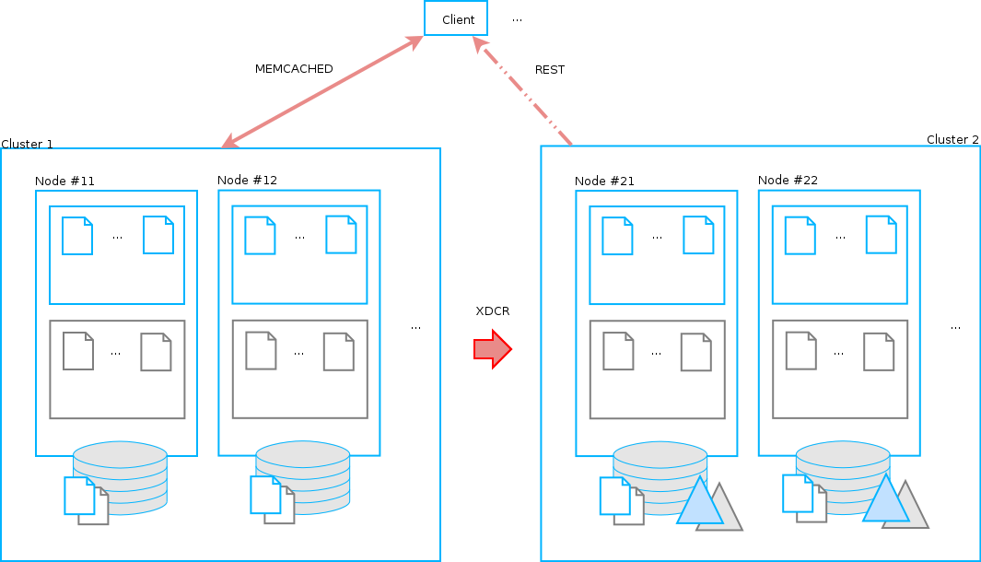
XDCR – Separated Cluster for Indexing
Separate the load
Reporting cluster vs. operational one
Active-Passive XDCR

Slide 25
Configuration Settings
and their Effects

Slide 26
Indexing Settings
Index Path
Separated disks for data and indexes
Improve I/O performance

Slide 27
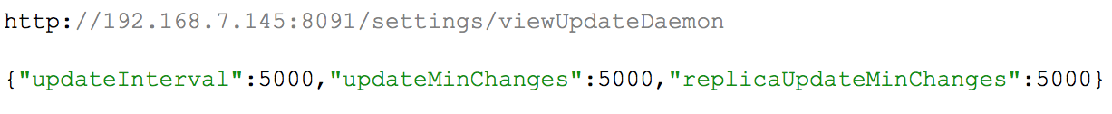
Indexing Settings
Indexing Interval
Controls how up-to-date the index is by default
‘stale = false’ as explained before

Slide 28
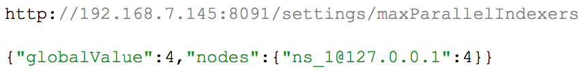
Indexing Settings
Max. number of in parallel working indexers
Increase the number of threads per node
Higher level of concurrency
Higher disk and CPU load

Slide 29
Rebalance Settings
Index-aware rebalance
Indexing by default as part of rebalancing
Ensures that you get query results from a new node during rebalance that are consistent with the query results you would have received from the node before rebalance started
Performance impact if enabled, so rebalance takes significantly more time

Slide 30
Rebalance Settings
Rebalance before compaction
Default is 16, so 16 vBuckets are moved before rebalance is paused for compaction
Higher value may increase rebalance performance
Implicitly increases rebalance priority

Slide 31
Rebalance Settings
Rebalance moves per node
Default is 1
Number of vBuckets moved at a time during the rebalance operation

Slide 32
Compaction Settings
(Auto) Compaction
Append only storage engine
In-place updates are expensive
Removes tombstone objects and fragmentation
Process Data and View compaction in parallel
Implies a heavier processing and disk I/O load during compaction process

Slide 33
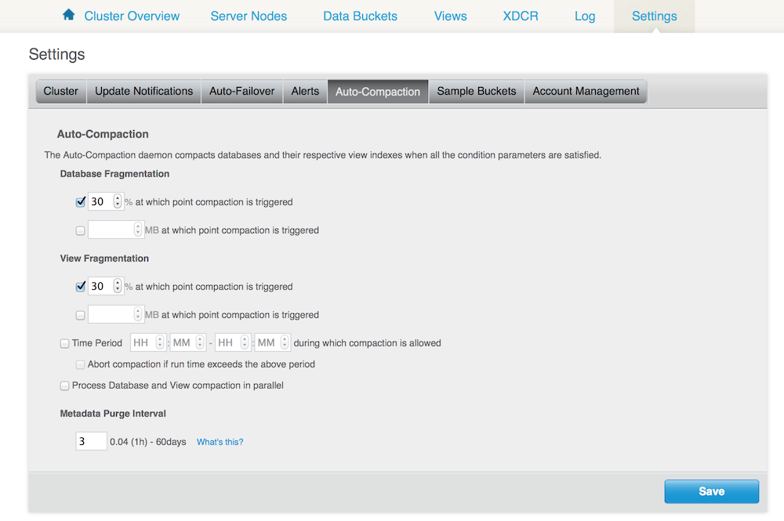
Compaction Settings

Slide 34
Resource Requirements

Slide 35
Resource Requirements
CPU | Disk (size, I/O)
Number of Views per Design Document
Number of the emitted items
Compaction
Complexity of Map/Reduce functions | Size of the emitted value
More CPU cores are recommended
Configure your OS File System Buffer!
Use SSD-s for Views!

Slide 36
Thank you! Q&A

